Slide 1
NAPLAN Practice Time
Clem Evans
Week 2 Term 2

Slide 2
Now you have completed your first NAPLAN Practice test, how did you go?
Can you improve?
What can you do to improve?
This lesson is designed to help you break your questions down, pull out the relevant information, identify the steps you need to take to successfully complete the questions.
Remember if you do well in your NAPLAN this year, you may not need to complete OLNA in years 10-12.

Slide 3
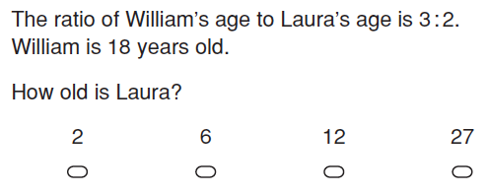
How could we solve this problem?
Talk to your partner and come up with a strategy.
Suggestions:
Notes:
Use the questions as prompts to get students to discuss what information is needed to answer the question. Then discuss strategies that may be used (if wrong strategies are suggested, follow them through to show how they will turn out and give students opportunities to change their minds) and model how to complete the problem.
Students should take notes on how to perform each function and use them when completing their practice tests.

Slide 4
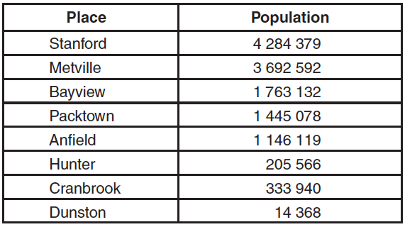
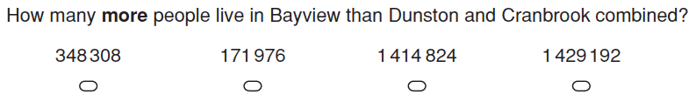
How could we solve this problem?
Suggestions:

Slide 5
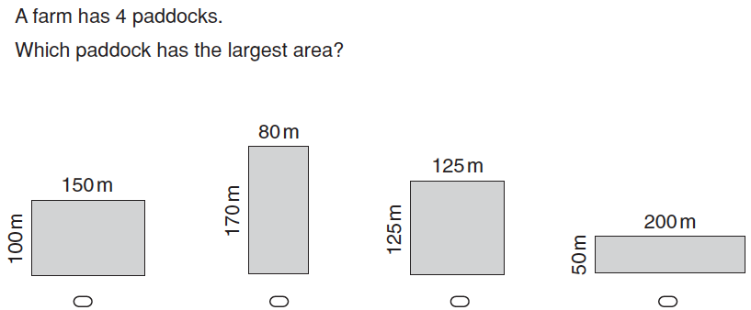
How could we solve this problem?
What information do we need from the question?
Suggestions:

Slide 6
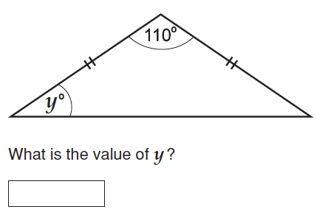
How could we solve this problem?
Suggestions:

Slide 7
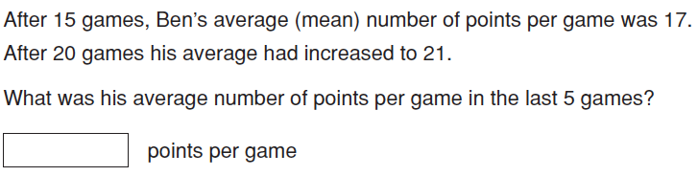
How could we solve this problem?
Try it yourself and be prepared to share your strategies.
Suggestions:

Slide 8
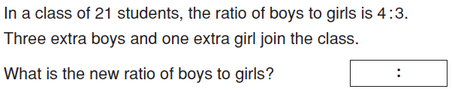
How could we solve this problem?
Suggestions:

Slide 9
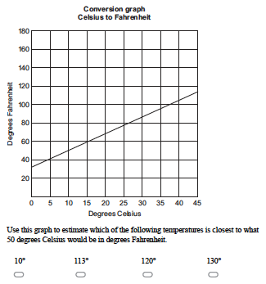
How could we solve this problem?
Suggestions:

Slide 10

How could we solve this problem?
Suggestions:

Slide 11
Now take all your notes and use them to create study notes for your NAPLAN Practice Test.
Notes:
Independent Practice will be in the form of the NAPLAN Practice Test.

